Slide 1
Horizon Results Booster Dissemination Modules
Info Session | 17th of November 2022
Prepared by Nicholas Ferguson

Slide 2
Who we are
Summary of Dissemination modules
Practical examples of HRB applicants
The modules in more detail

Slide 3
HRB Dissemination Modules
Module A
Results Portfolio
35 days
Project Group identified & formed
New connections & synergies
Joint dissemination actions
Why? Support researchers and projects to collaborate and form clusters through joint dissemination activities
Who? All types of ongoing or completed EC-funded projects:
Marie Curie, European Research Council, Research & Innovation, International Training Networks…..etc
When? – Apply and start any time with up to 4 months of support available
What? – Expert support from dissemination specialists and tangible outputs for use beyond HRB services
How? – 2 specific dissemination modules
Module B
Joint Dissemination Plan & Delivery
120 days
Plan of action
Joint dissemination materials
Online training
Dissemination actions
e.g. workshop/policy brief/online portfolio
Service providers: Experts in R&I dissemination
www.trust-itservices.com
www.icons.it
Services offered free of charge to the applicant project with HRB team funded by EC
Limited effort from applicant required | Return on effort high

Slide 4
Three examples of how we have helped projects
Cementing an existing network
Forest wood and construction
We are supporting the clustering and collaboration of 18 projects. However, for more effective implementation and dissemination of results, additional professional support is very welcome and, in fact, needed for tangible scientific research results to successfully reach relevant and diverse target audiences.
Targeting challenging stakeholders e.g. adopters of results
Cybersecurity
Identify and collaborate with other research activities around our cybersecurity priorities. In particular, cyber-ranges, education and training, understanding the threat landscape
Broadening horizons and networks
Climate change on Meditteranean ecosystems
As a result of the pandemic situation many restrictions have prevent us from carrying out most of the dissemination activities that we planned to perform in the proposal of our project. Although we did our best to compensate for this by reaching citizens via social media or on line activities, we feel the HRB service could help us reaching our goals of properly disseminate the results of our project.
Extremely flexible and tailored approach to each applicant project(s).
Real effort on our side to make the right connections and suggest the right activities.

Slide 5
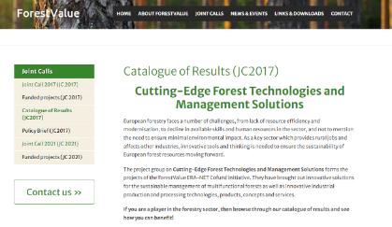
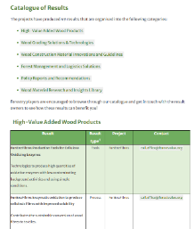
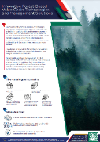
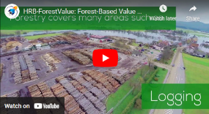
Cementing an existing network
AT A GLANCE
Project Group: 18 projects clustered
Mapping of KERS, identification of stakeholders, joint video & flyer, catalogue webpage and policy brief development
FOREST VALUE - Promoting innovation and competitiveness to transform from a resource-intensive to a knowledge-intensive, productive, resource-efficient and resilient sector.
A catalogue of the PG’s key results (59 in total) now exists online with short descriptions, relevant links, and contact points
PG now has a unified policy position summarized in an easily understandable reference document
ERA-NET Cofund Action
Policy Brief
PDESA, PDESB
2017 - 2023
Joint Online Catalogue of Results
Ministry of Agriculture and Forestry of Finland
Mika Kallio, Ministry of Agriculture and Forestry of Finland
“An opportunity for us to learn how such a large PG can come up with a joint results portfolio and actually link projects together”
www.forestvalue.org
Video
Fact sheet
Notes:
Activities
Mapping of KERS, identification of stakeholders, joint video & flyer, catalogue webpage and policy brief development
Main Achievements
PG now has a unified policy position summarized in an easily understandable reference document
A catalogue of the PG’s key results (59 in total) now exist online with short descriptions, relevant links, and contact points

Slide 6
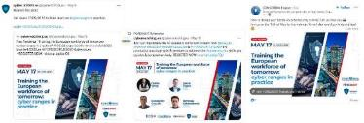
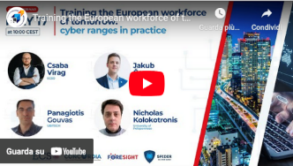
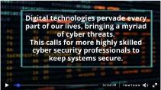
Targeting potential users of results
AT A GLANCE
Project Group: CONCORDIA, SPIDER & FORESIGHT
CONCORDIA - Interconnect all of Europe’s cybersecurity capabilities into a network of expertise to help build a secure, trusted, resilient and competitive ecosystem
Training the European workforce of tomorrow with a network of cyber range capabilities
Facilitating CONCORDIA to engage with other Cybersecurity projects on the specific topic of expanding the use of cyber ranges for SMEs
Webinar delivery and 360 support with 120 participants, live polling, social media campaign and joint policy brief
RIA – Resarch and Innovation Action
PDESA, PDESB
Webinar planning, recruitment & delivery
Project Group definition & strategy
Social media campaign
2019 - 2022
Masaryk University
Martin Horak, Masaryk University
Live polling & post-event adoption survey
I would like to express my gratitude to the whole team for the initiative, effort and a great looking final policy brief. I hope we can continue the great cooperation and possibly organise a final clustering event between our projects “Damir Haskovic MINDS & SPARKS & FORESIGHT
Joint video and factsheet
Post-event policy brief disseminated by the EC
www.concordia-h2020.eu
Notes:
Activities
Mapping of KERS, identification of stakeholders, joint video & flyer, catalogue webpage and policy brief development
Main Achievements
PG now has a unified policy position summarized in an easily understandable reference document
A catalogue of the PG’s key results (59 in total) now exist online with short descriptions, relevant links, and contact points

Slide 7
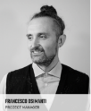
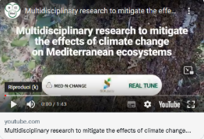
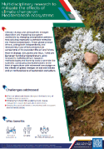
Broadening horizons and networks
AT A GLANCE
Project Group: Med-N-Change, SOILdarity & REAL TUNE
Med-N-Change - Assessing the interactive effects of Nitrogen addition and climate change on soil processes through the biological soil crust in Mediterranean ecosystems
How biocrust-forming organisms influence soil processes when subjected to atmospheric nitrogen deposition and/or climate change.
Creating new partnerships with SOILdarity (CSA) leading to greater outreach opportunities and leveraging their network
EXCELLENT SCIENCE - Marie Skłodowska-Curie Action
Continuous strategic support for online dissemination, online training, Social media campaign, workshop delivery
PDESA, PDESB
2019 - 2022
Centre for Ecology, Evolution and Environmental Changes, Faculdade de Ciências da Universidade de Lisboa (Portugal)
Project Group formation
Personalised strategic support for online dissemination strategies
Online dissemination training
Lourdes Morillas, PhD. Principal investigator
www.mednchange.weebly.com
Social media campaign
Workshop delivery 30+ participants
Video pill &
factsheet

Slide 8
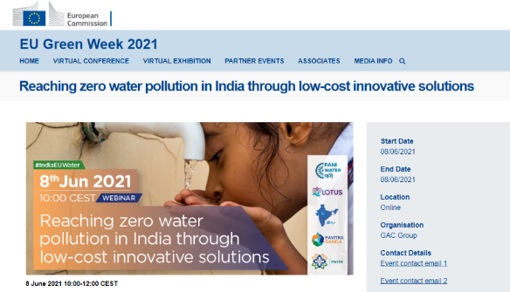
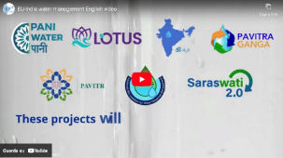
HRB Dissemination Modules
Identification of the Project Group → Identify and invite other projects
Data collection → Sharing specific information
Set up of online meeting → Establishing new connections
Mapping of results & stakeholders → Commonalities & Recommendations
Final report → Results portfolio report
Definition of joint communications plan → Action plan
Design & delivery of joint fact sheet & video pill → Joint identity & material to use immediately
Online training → Improving skill set
Support to deliver up to 2 joint dissemination activities →
Results portfolio
Online workshop/webinar
Social media campaign
Policy brief
Strategic support
Module A
Results
Portfolio
Duration: 35 days
Module B
Dissemination Plan & Delivery
Duration: 120 days
Simple and quick application to start right away

Slide 9
HRB offers support to…..
Address difficult to achieve dissemination objectives/KPIs.
Become the mover and shaker creating a new cluster and aligning on activities.
Cluster with other researchers or projects on topics or activities in common.
Share knowledge, expand networks and increase opportunities for collaboration and responding to future calls.
Jointly address more challenging Stakeholders through EC-approved activities e.g. Policy brief.
Leverage each projects/researchers’ networks, communication channels and expertise.
Co-organise of online/offline events or workshops to leverage cross-pollination and effectively showcase PG’s outcomes and results.
Get professional help in the creation of tangible and well-created dissemination items e.g. fact sheet & video pill.
Quick and easy to apply | Limited effort for researcher/project
Great opportunity to increase impact through dissemination

Slide 10
Nicholas Ferguson
n.ferguson@trust-itservices.com
www.horizonresultsbooster.eu

Slide 11
Broadening horizons and networks
AT A GLANCE
Project Group: Med-N-Change, SOILdarity & REAL TUNE
Med-N-Change - Assessing the interactive effects of Nitrogen addition and climate change on soil processes through the biological soil crust in Mediterranean ecosystems
How biocrust-forming organisms influence soil processes when subjected to atmospheric nitrogen deposition and/or climate change.
Creating new partnerships with SOILdarity (CSA) leading to greater outreach opportunities and leveraging their network
EXCELLENT SCIENCE - Marie Skłodowska-Curie Action
Continuous strategic support for online dissemination, online training, Social media campaign, workshop delivery
PDESA, PDESB
2019 - 2022
Centre for Ecology, Evolution and Environmental Changes, Faculdade de Ciências da Universidade de Lisboa (Portugal)
Project Group formation
Personalised strategic support for online dissemination strategies
Online dissemination training
Lourdes Morillas, PhD. Principal investigator
www.mednchange.weebly.com
Social media campaign
Workshop delivery 30+ participants
Video pill &
factsheet

Slide 12
Capacity Building Course
Based on the gaps & needs identified during the convergence call, the Service Team will: • Prepare standardised and tailored course content • Upload the capacity building course in the IB platform
The capacity building will include both prescriptive learning and real-case tasks tailored to the PG, thus providing a concrete value and pay-off in respect of practical use.
The capacity building is organised around three training packages which will be completed in a self-study online mode enabling participants to complete them in their own time:
Training package A. Strategy
Training package B. Implementation
Training package C. Monitoring
The training material will be available on the Workspace for 15 days during which the Service Team and it is supposed to start after Day 61 (with flexibility)

Slide 13
Joint dissemination outputs Pick and choose up to 2 Dissemination Expert Packages (DEP)
DEP 1: On-tap strategic guidance (“ad hoc” support)
DEP 2: Copywriting and content creation
DEP 3: Communicating to Policy & Decision Makers
DEP 4: Event Support
DEP 5: Social Media Presence
DEP 6: Customised Package

Slide 14
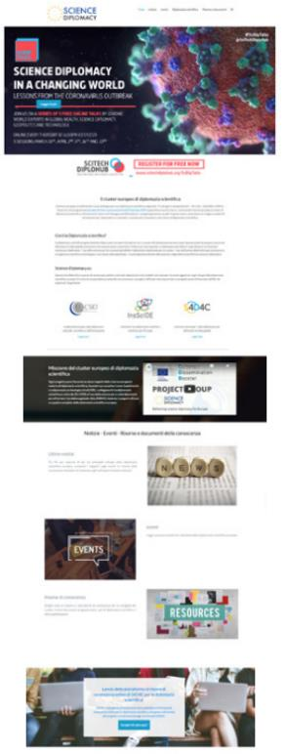
Overview of the 6 Dissemination Experts Packages – Part 1/3 (expected Start at day 61 but flexibility admitted) - Pick and choose up to 2 DEPs!
DEP 1: On-tap strategic guidance (“ad hoc” support) The Service Team will provide continued support to the PG through the following actions: • Monitoring & Counseling on task delivery • Maximum of 3 conference calls to track activity and provide guidance • Regular email contact with task leaders • Feedback on dissemination progress and outputs • KPI set up and monitoring
DEP 2: Copywriting and content creation The Service Team can support in the writing of specific content items: • 1 joint website page presenting the project group and results • Collection and editing of service-offer type texts from all projects in the PG • 1 PG overview text which can serve as a news-piece • Proof-reading and editing of content created by PG
Joint Webpage example

Slide 15
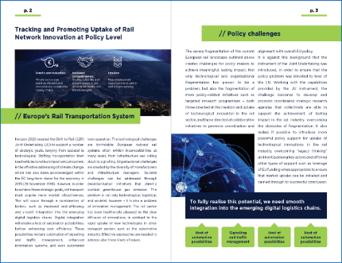
Overview of the 6 Dissemination Experts Packages – Part 2/3 (expected Start at day 61 but flexibility admitted) - Pick and choose up to 2 DEPs!
DEP 3: Communicating to Policy & Decision Makers The Service Team will support the PG in preparing a policy brief document: • Support in identifying related policy priorities • Copywriting and message sharpening • 3 Conference Calls to manage the document • Creation of a professionally designed booklet/Policy brief ready for dissemination
See examples here.
DEP 4: Event Support The Service Team provides various type of support for event organization and management: • Agenda design & logistics (creation of an official banner or collaterals, media kit support & advice) • Promotional Campaign through Social Media and Stakeholder’s network • Messaging and recruiting speakers and participants • Tangible event outputs (i.e. post-event reports, live twitting, social media broadcasting, interview’s editing..)
Policy brief booklet (example)

Slide 16
Overview of the 6 Dissemination Experts Packages – Part 3/3 (expected Start at day 61 but flexibility admitted) - Pick and choose up to 2 DEPs!
DEP 5: Social Media Presence The Service Team provides support for dissemination through social media channels: • Set-up social media accounts (if needed) • Social Media Management (fortnightly) • Social Media engagement • Sponsored Campaigns
Kpi Setting and Monitoring (Flash Report set-up)
DEP 6: Customised Package The PG can select any of the above options and the Service Team will allocate resources accordingly: • Composition of any of the abovementioned activities
Twitter Cards for Social Media campaign (example)

